Slide 1
Gunpowder River Woody Debris
York Road to Bunker Hill Road
Distance ≈ 2mi. (3.1 k)
March 17, 2011

Slide 2
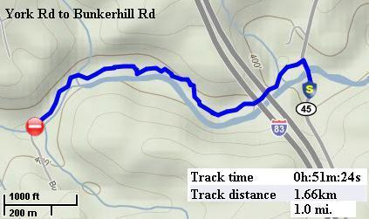
Continuous photo inventory of woody debris
GPS recorded route

Slide 3
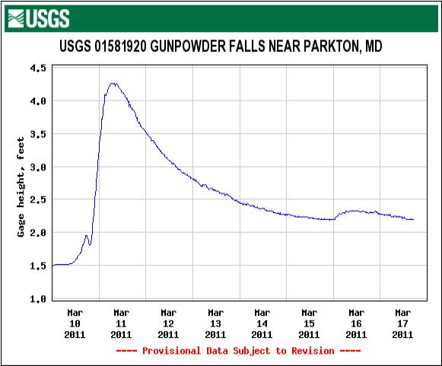
Flow

Slide 4
Station 1 Start

Slide 5
Station 2a

Slide 6
Station 2b

Slide 7
Station 3

Slide 8
Station 4

Slide 9
Station 5

Slide 10
Station 6

Slide 11
Station 7

Slide 12
Station 8

Slide 13
Station 9

Slide 14
Station 10

Slide 15
Station 11

Slide 16
Contact Information
Charles Hihn
18426 Gunpowder Rd
Hampstead, MD 21074
buddyh@hiventures.com
410-374-4164

